Slide 1
Microsoft Dynamics AX 2012 Administration Workshop Chapter 9: System Monitoring

Slide 2
Conditions and Terms of Use
Microsoft Confidential
This training package is proprietary and confidential, and is intended only for uses described in the training materials. Content and software is provided to you under a Non-Disclosure Agreement and cannot be distributed. Copying or disclosing all or any portion of the content and/or software included in such packages is strictly prohibited.
The contents of this package are for informational and training purposes only and are provided "as is" without warranty of any kind, whether express or implied, including but not limited to the implied warranties of merchantability, fitness for a particular purpose, and non-infringement.
Training package content, including URLs and other Internet Web site references, is subject to change without notice. Because Microsoft must respond to changing market conditions, the content should not be interpreted to be a commitment on the part of Microsoft, and Microsoft cannot guarantee the accuracy of any information presented after the date of publication. Unless otherwise noted, the companies, organizations, products, domain names, e-mail addresses, logos, people, places, and events depicted herein are fictitious, and no association with any real company, organization, product, domain name, e-mail address, logo, person, place, or event is intended or should be inferred.
Copyright and Trademarks
© 2013 Microsoft Corporation. All rights reserved.
Microsoft may have patents, patent applications, trademarks, copyrights, or other intellectual property rights covering subject matter in this document. Except as expressly provided in written license agreement from Microsoft, the furnishing of this document does not give you any license to these patents, trademarks, copyrights, or other intellectual property.
Complying with all applicable copyright laws is the responsibility of the user. Without limiting the rights under copyright, no part of this document may be reproduced, stored in or introduced into a retrieval system, or transmitted in any form or by any means (electronic, mechanical, photocopying, recording, or otherwise), or for any purpose, without the express written permission of Microsoft Corporation.
For more information, see Use of Microsoft Copyrighted Content at http://www.microsoft.com/about/legal/permissions/
Microsoft®, Internet Explorer®, Outlook®, SkyDrive®, Excel®, Windows Vista®, Zune®, Xbox 360®, DirectX®, Windows Server®, Microsoft Dynamics® and Windows® are either registered trademarks or trademarks of Microsoft Corporation in the United States and/or other countries. Other Microsoft products mentioned herein may be either registered trademarks or trademarks of Microsoft Corporation in the United States and/or other countries. All other trademarks are property of their respective owners.

Slide 3
Students: How to View this Presentation
Switch to Notes Page view
Click View on the ribbon and select Notes Page
Use page up or page down to navigate
Zoom in or out as needed
Most slides will have supporting text that you can view now or after the delivery
Add notes to your copy of the presentation if you want to
You take the presentation files home with you

Slide 4
Overview
This chapter will provide an overview of some of the most useful monitoring and troubleshooting tools available for Microsoft Dynamics AX.

Slide 5
Objectives
Review the most common tools for monitoring and troubleshooting Microsoft Dynamics AX
Review how to setup and use each tool
Understand when and how to use each tool

Slide 6
Introduction
Several tools are available for monitoring and troubleshooting Microsoft Dynamics AX
Performance Monitor
Microsoft Dynamics AX 2012 Management Pack for System Center Operations Manager (SCOM)
Client Access Log
SQL Statement Trace Log
Connection Context
Trace Parser
Performance Analyzer for Microsoft Dynamics
Diagnostic Framework for Microsoft Dynamics AX (Beta)

Slide 7
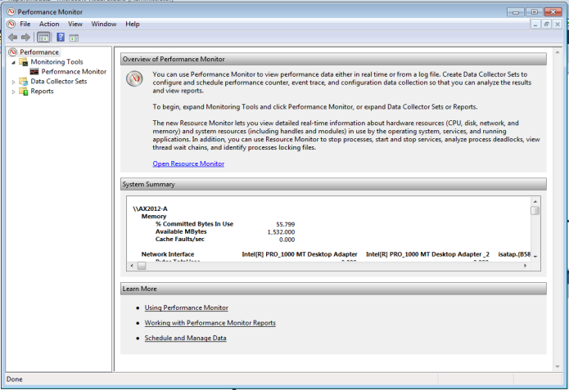
Performance Monitor Overview
Discuss thresholds for critical performance counters
Processor
Memory
Disk
Network
Microsoft Dynamics AX and SQL Server specific counters

Slide 8
Application Object Server (AOS) Performance Thresholds
Processor
% Processor time – sustained values above 80% may indicate a processor bottleneck
Memory
Available Mbytes – dropping below 100 MB may indicate a memory bottleneck
Disk
Avg Disk sec/read and Avg disk sec/write – sustained values above 15 ms may indicate a disk bottleneck
Network
Output queue length – sustained values above 0 indicate queuing and a possible network bottleneck
Microsoft Dynamics AX Object Server
Active sessions – informational

Slide 9
SQL Server Performance Thresholds
Processor
% Processor time – sustained values above 80% may indicate a processor bottleneck
Memory
Available Mbytes – dropping below 100MB may indicate a memory bottleneck. Prevent by setting max server memory configuration option in the SQL Server
Disk
Avg Disk sec/read and Avg disk sec/write – sustained values above 10ms may indicate a disk bottleneck. Values above 25ms are critical
Network
Output queue length – sustained values above 0 indicate queuing and a possible network bottleneck

Slide 10
SQL Server Performance Thresholds
SQL Server: Buffer Manager
Buffer cache hit ratio – values below 98% may indicate a memory bottleneck or inefficient data access (lots of scanning)
Page life expectancy – values below 300 seconds may indicate a memory bottleneck or inefficient data access (lots of scanning). On large memory system (64+ GB), values should stay well above 1200 seconds

Slide 11
Microsoft Dynamics AX Management Pack for System Center Operations Manager (SCOM)
Discovers the Microsoft Dynamics AX environment
Monitors the servers and application
Makes administrative tasks easier

Slide 12

SCOM and the Microsoft Dynamics AX Management Pack
SCOM Versions Supported
SCOM 2007 R2
SCOM 2012
Server Discovery
SQL Server
AOS Server
Enterprise Portal Server
SQL Server Reporting Services (SSRS) Server
Application Component Discovery
AOS instances and clusters
Microsoft Dynamics AX database
Application Integration Framework
SQL Server Analysis Services (SSAS) Server
Batch Framework
Enterprise Portal sites
Reporting Services instances

Slide 13
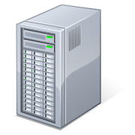
SCOM and the Microsoft Dynamics AX Management Pack
Server Discovery - Specify an AOS to act as discovery engine and “watcher” for end-to-end tests such as RPC and Windows Communication Foundation (WCF) pings and WCF calls. It’s the first installed AOS if not explicitly changed.
SCOMPERFORMANCEAOS
AX SQL
AOS
EP
SELECT VALUE
FROM SYSGLOBALCONFIGURATION
WHERE NAME = 'SCOMPERFORMANCEAOS'
SSAS
SSRS

Slide 14
Microsoft Dynamics AX Management Pack Monitoring
SQL Server Configurations
AOS event logs
Services running
AOS – WCF and Remote Procedure Calls (RPC) pings, service calls
EP – Web site available
Report server – Report server URL available
Batch jobs waiting

Slide 15
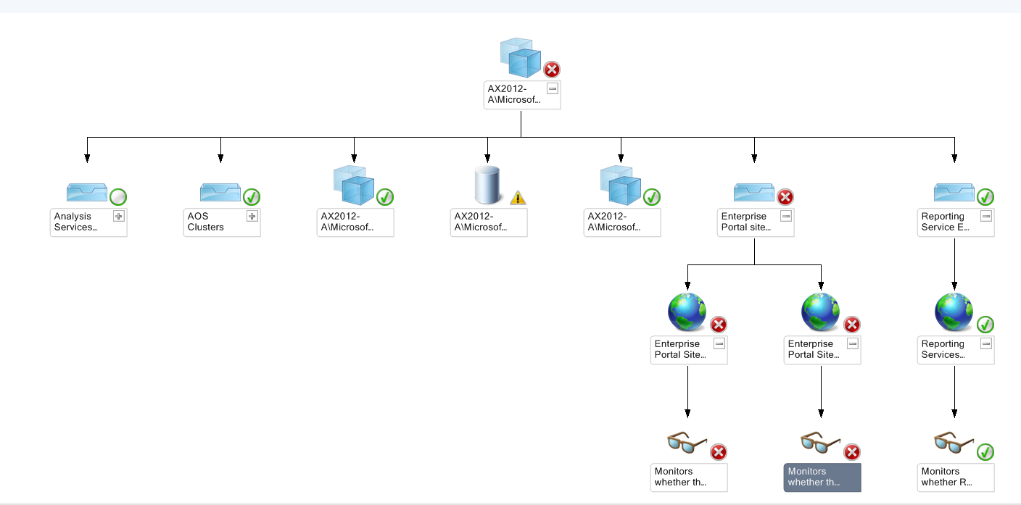
SCOM and the Microsoft Dynamics AX Management Pack
Diagram view of Microsoft Dynamics AX with status by node
Notes:
Red X = Critical issue
Yellow triangle = Warning
Green check = No issues

Slide 16
Video: Using the Management Pack for Microsoft Dynamics AX
Your instructor will show a video on using the Management Pack for Microsoft Dynamics AX
Notes:
Use video CCAX2012HT0108-ManagementPackOverview.wmv

Slide 17
Client Access Log Overview
Logs response times and errors for Microsoft Dynamics AX client forms
Used to analyze end user usage patterns and proactively address bottlenecks
Reference data to assist in troubleshooting errors reported
Data is not real-time
Logging functionality native to Microsoft Dynamics AX is disabled by default
Ability to read the data requires an additional installation

Slide 18
Client Access Log
Enable logging – Update UserInfo table
Track activity - In memory on Microsoft Dynamics AX client
Persist activity - SysClientAccessLog table (container field in AX DB)
Extract records - Client Access Log form
View activity – Client access log form or query ClientAccessLogFlat table directly

Slide 19
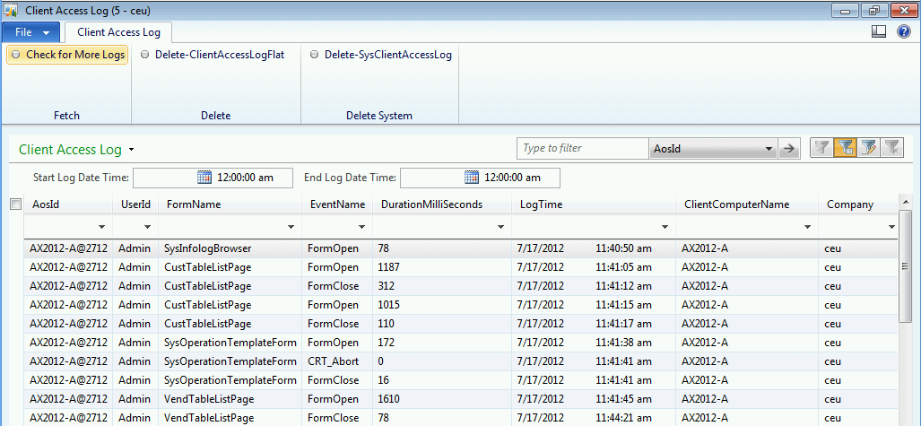
Client Access Log Form
Use to view/manage client activity logs
Notes:
The sample form shown above can be used to view the Client Access Log information. It can be downloaded from http://blogs.msdn.com/b/axperf/archive/2011/10/14/client-access-log-dynamics-ax-2012.aspx

Slide 20
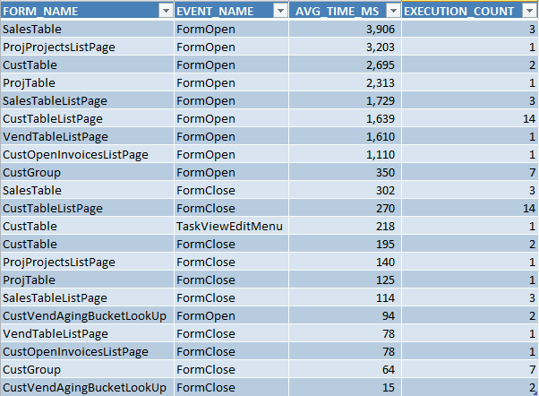
Client Access Log Data
Extracted/aggregated data viewed in Excel

Slide 21
SQL Statement Trace Log Overview
Track long running queries; for example all queries that take longer than 5 seconds to execute
Helps answer questions such as:
What user was involved?
How long did the query take?
What code path was executed to fire the query?

Slide 22
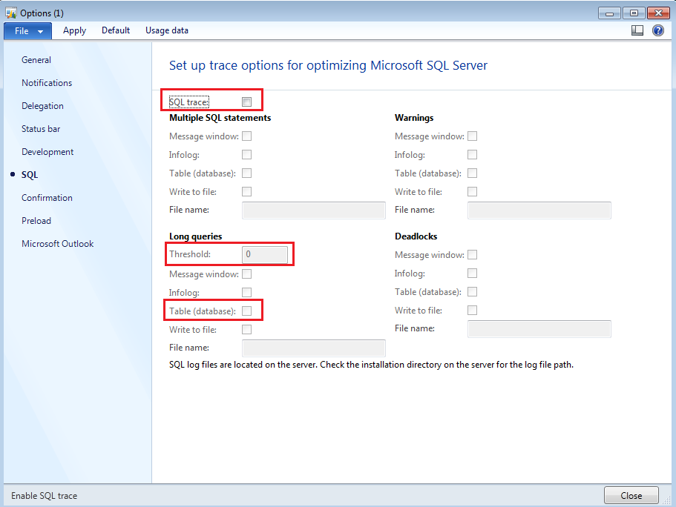
SQL Statement Trace Log Setup
Tools > Options > SQL tab
Setup per user to track long running queries.
Warning: Do not set threshold lower than 2000ms to avoid performance issues.

Slide 23
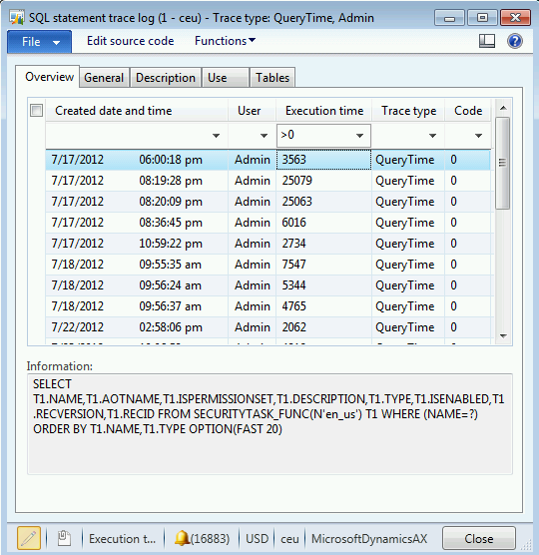
View SQL Statement Trace Log Data
System Administration > Inquiries > Database > SQL statement trace log

Slide 24
Microsoft Dynamics AX Connection Context Feature
Use to identify an AX user session in SQL Server
There is no SPID column available in the AX Online users form in Microsoft Dynamics AX 2012 as there was in previous versions
Feature disabled by default
Must be manually enabled in the registry for each AOS instance
View AX user connection details in SQL Server Management Studio (SSMS)
Notes:
Troubleshooting database performance [Microsoft Dynamics AX 2012]
http://technet.microsoft.com/en-us/library/hh699644.aspx
Include session information in the SQL Server connection context
Click Start, click Run, type regedit in the Open box, and then click OK.
Locate the following registry key:
HKEY_LOCAL_MACHINE\SYSTEM\CurrentControlSet\services\Dynamics Server\6.0\01\Original (installed configuration)
The Original (installed configuration) key is the key name for the current server configuration, if the configuration has not been changed from the default. If your system uses a configuration other than the configuration that was originally installed, locate the configuration that is currently active.
Right-click the key, point to New, and then point to String value. Name the new value connectioncontext, and set the value to 1.
Close the registry editor.
Start the Services snap-in, and then restart the Application Object Server (AOS) service.

Slide 25
Notes Continued
Notes:
Find session information
Open Microsoft SQL Server Management Studio.
Run the following query to view all sessions that are related to Microsoft Dynamics AX:
select cast(context_info as varchar(128)) as ci,* from sys.dm_exec_sessions where program_name like '%Dynamics%'
The first two items in the ci (connection information) column are the Microsoft Dynamics AX user ID and the session ID.
In the Online users form, you can now identify each session.

Slide 26
SSRS Execution Log Overview
Track SSRS report usage statistics
What reports are executed most frequently?
What reports have the longest run times?
What report parameters are being used?
Query the data directly from the Executionlog3 view in the Report Server database or create some SSRS reports that show the data.

Slide 27
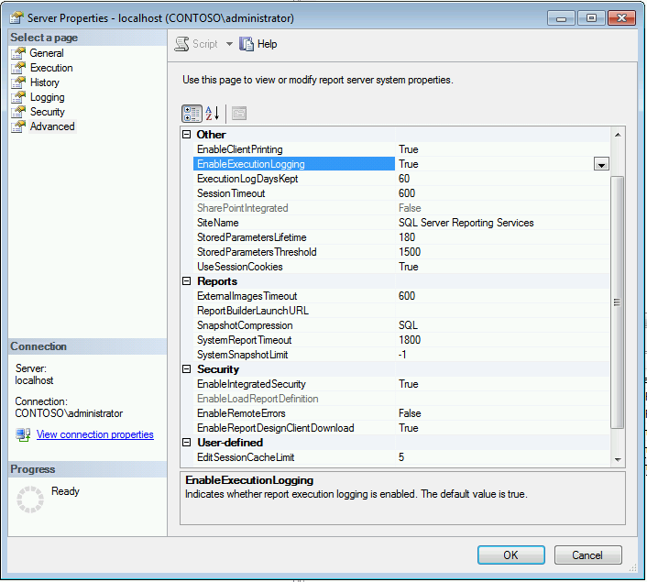
SSRS Execution Log Setup
SSMS > Reporting Services Instance > Properties > Advanced > EnableExecutionLogging
Notes:
Open SQL Server Management Studio and connect to the Microsoft Dynamics AX Report Server.
Select the Report Server name and right-click on it and choose Properties
In the Property form, make sure the EnableExecutionLogging option is set to TRUE

Slide 28
SSRS Execution Log Data
Sample ExecutionLog3 Query
--Top 25 longest running reports in the last 14 days
SELECT TOP 25
ItemPath AS Report_Path,
AVG(TimeDataRetrieval + TimeProcessing + TimeRendering) as Report_Time_ms,
COUNT (ItemPath) as Execution_Count,
AVG(ByteCount) as Avg_Size_Bytes,
AVG([RowCount]) as Avg_Row_Count
FROM EXECUTIONLOG3
WHERE DATEDIFF(dd,TimeEnd, GETDATE()) <= 14
GROUP BY ItemPath
ORDER BY Report_Time_ms DESC
Notes:
Note: By default, log entries are kept 60 days. Entries that exceed this date are removed at 2:00 A.M. every day.

Slide 29
Microsoft Dynamics AX Application Tracing
X++ code
Can be traced in the Microsoft Dynamics AX tracing cockpit
Can be analyzed with Trace Parser tool
Services, batch, and other CIL code
Can be traced with Visual Studio Profiler
Can be analyzed in Visual Studio
Performance analysis tool
Procedure: Install trace parser
Procedure: Configure trace parser for use
Notes:
Best Practice: Using a local SQL server instance is recommended instead of the production environment.
Microsoft Dynamics AX 2012 Trace Parser is a performance analyzer that helps users discover and resolve performance problems in customized Microsoft Dynamics AX systems. Unlike previous versions where it was a separate tool, Trace Parser is now a component within the Microsoft Dynamics AX 2012 client.
Trace Parser provides a user interface to import, process, and render ETW tracing events that are produced by Microsoft Dynamics AX. Users can analyze tracing events to identify performance bottlenecks such as long-running X++ methods, slow SQL queries, and frequently called RPCs.
The features in Trace Parser can help users determine the root causes of performance problems.
Install and set up Trace Parser
Trace Parser can be installed using the Microsoft Dynamics AX 2012 setup program. Trace Parser requires .Net Business Connector and you will need access to a SQL Server 2008 instance (Enterprise or Developer edition) with admin permissions.
Best Practice: Using a local SQL server instance is recommended instead of the production environment.

Slide 30
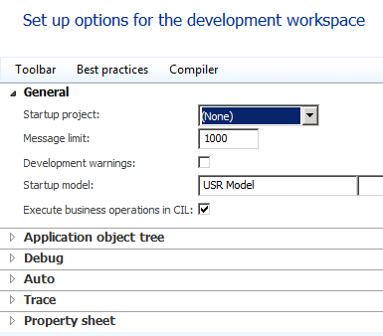
Microsoft Dynamics AX Application Tracing (continued)
CIL can be disabled in some cases
File > Tools > Options > Development > General > Execute business operations in CIL
Only do this in a test environment to facilitate tracing

Slide 31
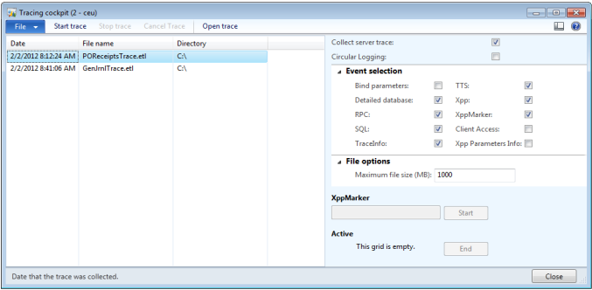
Collect a Trace using the Tracing Cockpit
The Tracing cockpit form is used to collect a trace file for client and server events
AX Development Workspace > Tools > Tracing cockpit
Notes:
Procedure: Collect Trace Files
In this procedure, you will set up the system to collect a server and client trace of the General journal creation process and then import the trace file into the Trace Parser utility for analysis.
Start Microsoft Dynamics AX 2012 client and switch to Development Workspace.
Go to Tools>Tracing cockpit.
Specify to Collect server trace
Check all of the boxes in the Event selection section
Leave the default Maximum file size (MB)
Click Start trace.
Specify a location and trace file name, C:\GenJrnlTrace.etl
Important: By default, the “Bind Parameters” and “Xpp Parameters Info” events are unchecked. This is to avoid capturing confidential information which could be exposed through the parameters of X++ methods and SQL queries. Always ask your customer or IT Admin whether it's OK to collect this information. If you have cleared the legal and privacy concerns, we recommend you check the options to collect more useful information.

Slide 32
Notes Continued
Notes:
“Replay” the scenario that you are investigating in Microsoft Dynamics AX client.
Go to General ledger>Journals>General journal.
Click New.
Select Name GenJrn from dropdown.
Click Lines button.
Enter first selection from dropdown under Account.
Enter $100.00 in Credit.
Enter second selection from dropdown under Offset Account .
Click Post>Post.
Once done, click the “Stop trace” button in Tracing Cockpit.

Slide 33
Import a Trace using Trace Parser
Use the Tracing cockpit form to import the trace into Trace Parser.
AX Development Workspace > Tools > Tracing cockpit
Notes:
Procedure: Analyze Trace Files
Within the Tracing cockpit, select the GenJrnlTrace.etl that you just created in the previous procedure.
Click Open Trace.
Trace Parser displays the overview of the imported trace. The overview gives users quick ideas about the “hot spots” in the trace by showing the top-most expensive X++ method calls and SQL statements across all sessions. You can check the “Show summary across all sessions” checkbox to display the overview of the trace across all sessions.
Select a session from the session list.

Slide 34
Analyze a Trace in Trace Parser
The Call Tree tab organizes and renders tracing events in a tree-like UI control
The events are organized as a list of “call stacks” in chronological order
The X++/RPC tab displays information about X++ and RPC events in a sortable data grid
It has two sub-views: Aggregate and non-Aggregate
The SQL tab is very similar to X++/RPC report; SQL report displays SQL events in a sortable data grid
Available for server traces only

Slide 35
Performance Analyzer for Microsoft Dynamics
The Performance Analyzer for Microsoft Dynamics allows you to capture performance data
The Performance Analyzer consists of several components:
Performance Database
Windows Performance Counters
Server-Side Tracing
AOT Metadata
AOS Analysis
Notes:
The Performance Analyzer for Microsoft Dynamics allows you to capture performance data. The Performance Analyzer consists of several components which are installed on multiple servers.
Performance Database: The DynamicsPerf database is created and deployed on the Database Server and captures the system configuration and performance data. Configurations include SQL configurations, Database configurations, and file configurations while performance data includes index statistics and query statistics
Windows Performance Counters: Performance counter templates are installed on the Database Server, AOS Server(s), Web Server(s), and Remote Desktop Server(s). The templates are enabled and produce performance counter log files which can be easily analyzed over time
Server-Side Tracing: Lightweight server-side tracing is enabled and generates trace files which capture important events such as blocking and deadlocks
AOT Metadata: Important properties from the AOT are exported such as Table cache settings and Index settings
AOS Analysis: This process dumps the local registry and event logs from the AOS Server(s) for analysis of important AOS configuration parameters and critical errors

Slide 36
Performance Analyzer Setup
Procedure: Deploy and configure Performance database
Procedure: Auto capture performance data
Procedure: Capture long running queries from AX code
Procedure: Collect AOT metadata
Procedure: Collect AOS settings and events
Procedure: Capture database blocking events
Notes:
Before you begin
Download and extract Performance Analyzer for Microsoft Dynamics from the following location: http://archive.msdn.microsoft.com/DynamicsPerf
Scenario: Deploy Performance Analyzer
Simon, the Systems Implementer, wants to deploy Performance Analyzer on his production system to more proactively monitor and tune his Microsoft Dynamics AX 2012 system.
Procedure: Deploy and Configure Performance Database (DynamicsPerf)
Unzip the Performance Analyzer 1.16 for Microsoft Dynamics.zip file into a folder.
Open SQL Server Management Studio (SSMS).
Click File > Open > Project/Solution.
Select Performance Analyzer 1.16 for Microsoft Dynamics.ssmsln file.

Slide 37
Diagnostic Framework for Microsoft Dynamics AX (Beta)
On-premise web-based tool that can be configured to perform the following tasks:
Collect data from Dynamics AX servers.
Run rules on the collected data.
Report rule violations on a dashboard.
Provide reports.
Tool can be downloaded from InformationSource https://informationsource.dynamics.com
Notes:
Rules are organized into modules that test conditions and raise messages. Modules consist of data collectors, transformations, and rules. A base set of modules and reports is distributed and installed with the framework. Modules can be exported and imported. For example, independent software vendors (ISVs) can develop modules based on their Microsoft Dynamics AX features, export the modules, and provide those modules to customers for import into the Diagnostic Framework.
Data can be collected from multiple sources, such as the Microsoft Dynamics AX database, Microsoft Windows Performance Monitor counters, Windows events, and Windows registry hives. Data is collected by using jobs that run either on predefined schedules or on demand.
The supported versions of Microsoft Dynamics AX include:
Microsoft Dynamics AX 2012 R2
Microsoft Dynamics AX 2012 Feature Pack
Microsoft Dynamics AX 2012
Microsoft Dynamics AX 2009

Slide 38
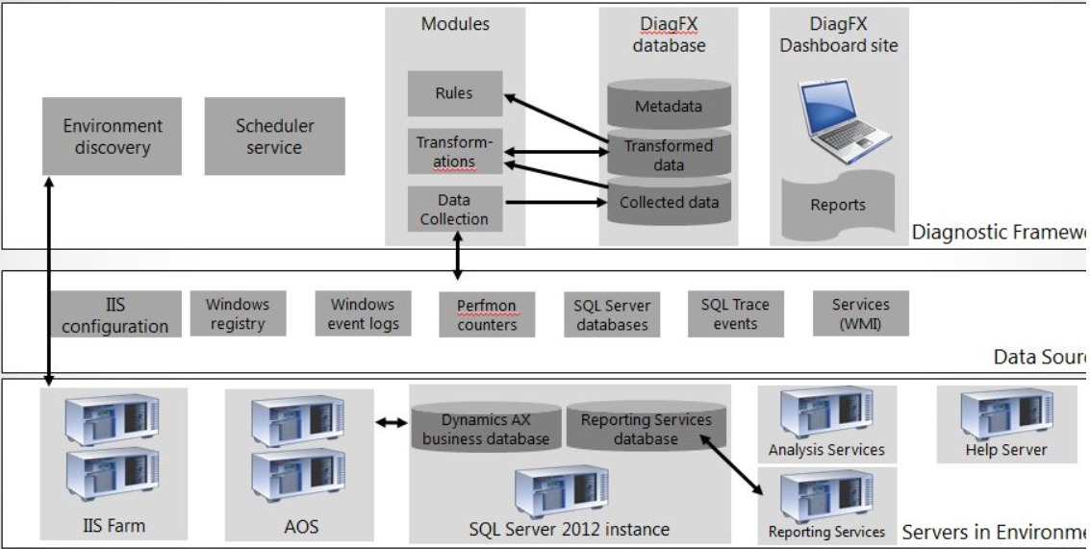
Diagnostic Framework for Microsoft Dynamics AX (Beta)
Architecture

Slide 39
Activity: Test Your Knowledge
The class will complete this section

Slide 40
Chapter Review
The Microsoft Dynamics AX Management Pack for SCOM can discover the following (click all that apply):
( ) AOS instances.
( ) Reporting services instances.
( ) Enterprise Portal websites.
( ) Microsoft Dynamics AX clients.
True or False? The Trace Parser helps users discover and resolve performance problems in Microsoft Dynamics AX systems?
( ) True
( ) False
True or False? The SQL Server database that is required for Trace Parser must be on the production Microsoft Dynamics AX database server?
( ) True
( ) False

Slide 41
Chapter Review (Answers)
The Microsoft Dynamics AX Management Pack for SCOM can discover the following (click all that apply):
(x) AOS instances.
(x) Reporting services instances.
(x) Enterprise Portal websites.
( ) Microsoft Dynamics AX clients.
True or False? The Trace Parser helps users discover and resolve performance problems in Microsoft Dynamics AX systems?
(x) True
( ) False
True or False? The SQL Server database that is required for Trace Parser must be on the production Microsoft Dynamics AX database server?
( ) True
(x) False

Slide 42
Chapter Summary
In this chapter, you learned:
About the most common tools for monitoring and troubleshooting Microsoft Dynamics AX.
How to set up and use each tool.
When and how to use each tool.

